Slide 1

Supermarkt Database
Team 04

Slide 2
Supermarkets have shelves where products are displayed and sold. Each shelf has a unique ID and belongs to a specific category. Products on the shelves are sourced from various suppliers, identified by unique IDs and company names. Supermarket employees, identified by unique IDs and job titles, keep the shelves stocked and organized, and assist customers. Customers, identified by unique IDs and contact information, can place orders in-store or online, and orders are fulfilled using the inventory. Sales are recorded, tracked and used to restock shelves and manage inventory.
introduction

Slide 3
Why we need a DBMS?
*Efficiently manage
*Find information.
*Take decisions
*Analyze sales.
*Generate reports.

Slide 4
Mainly Focus On
Customers:
Employees:
Products:
Suppliers:
Orders:
Shelves:

Slide 5
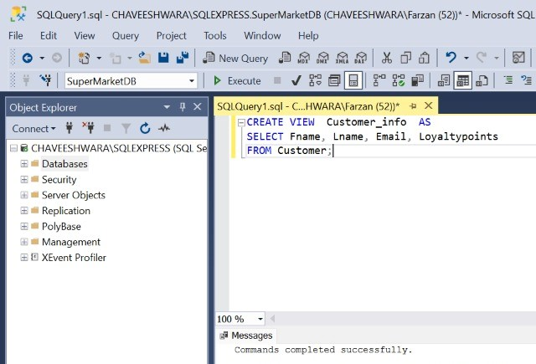
View Usage
Customer_info is used by the Manager and the Admin to view ther’e Loyalty points

Slide 6
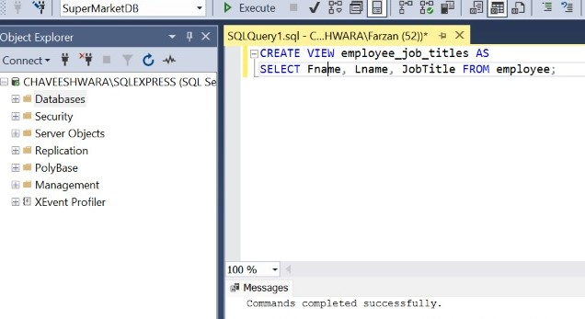
View Usage 2
This view is used by the manager to see the Employee job title.

Slide 7
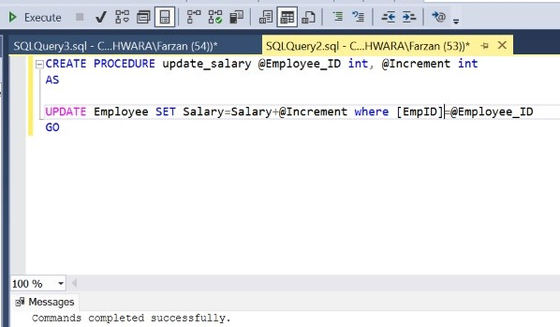
Procedure Usage
This Procedure- is used by admin and manager can access this too
This will help to increment the salary of the employees

Slide 8
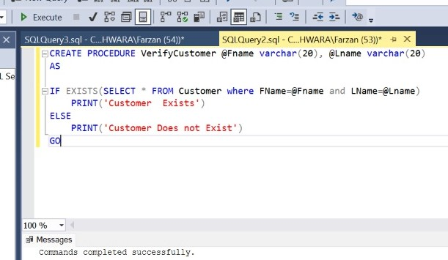
Procedure Usage 2
This procedure- is used by admin and manager can access this too
This will help to find whether the customer is available in the system or not

Slide 9
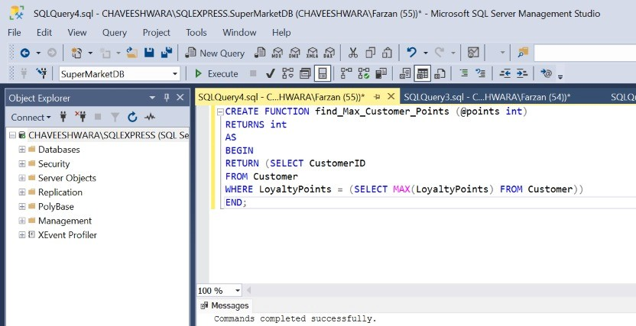
Function Usage
This function is used by admin and manager can access this too
This will help to find the Customer who got the maximum number of loyalty points.

Slide 10
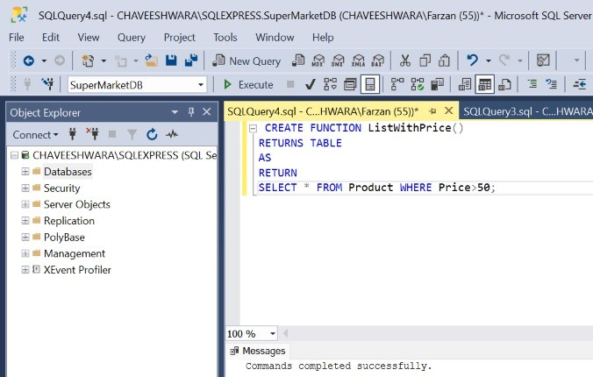
Function Usage 2
This function is used by admin and manager can access this too
This will help to find the Product which are over the price than 50.

Slide 11
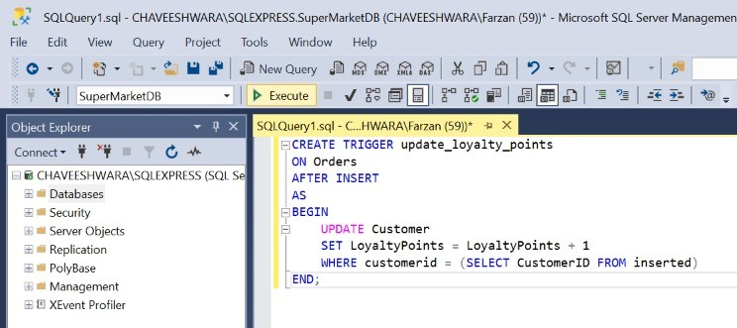
Trigger Usage
This trigger is used to update loyalty points in customer table ,every time when a new row is inserted in orders table .

Slide 12
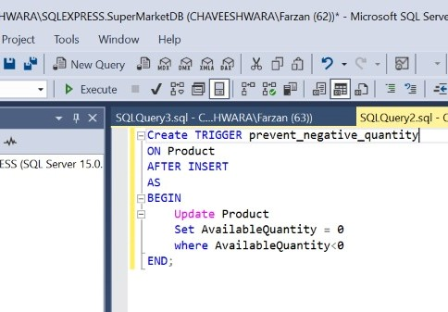
Trigger Usage 2
This trigger is used to easy the work of the admin .this will prevent entering negative quantity to the available Quantity column

Slide 13
End.

